Slide 1
Python
For Healthcare Administrative Data

Slide 2
And now for something completely different: Fun Facts

Slide 3


Slide 4
Fun Facts
Python refers to Monty Python - the languages creator was a big fan
Python is older than Java (1991 versus 1995)
Consistently above top 10, if not top 5, on programming language popularity lists
Python is maintained/developed by Open Source community efforts
Open source solutions are generally created by professionals looking for better tools
Being free solutions, they are generally driven by acceptance and community need

Slide 5
Python - “There’s a package for that”
Base Python - core programming language
Packages - extensions, often written in Python itself, or other languages ‘C’ for the most part, that add high level functionality to programs
Packages we care about:
Numpy - does fast math on arrays (C-code under the hood)
Matplotlib - pretty graphs
Pandas - allows for handling data in the form of:
Tables or datasets or dataframes (Columns and Rows)

Slide 6

Pandas Package
Sorry this one doesn’t have a cute story about its’ name - it’s derived from ‘PANel DAta’ :(
Base Python does not have an idea of a table/dataset/dataframe, Pandas is a standard extension that brings user support for tables/datasets/dataframes.
Pandas has a few ways of approaching dataframes, sub-syntax approaches, that when learning can be tricky, but each approach has pros and cons.

Slide 7
From SQL to Pandas
Structured Query Language
Designed specifically to interact with relational databases
Imperative language - specify *WHAT* is wanted, not *HOW* results are arrived at
There’s an optimizer that reads code and create an execution plan
Quite different from most general purpose programming languages
GP languages generally require to specify not only ‘what’ but ‘how’
Pandas - Dataframes are analogous to tables - Many GPL features will be new eg, loops

Slide 8

From SAS to Pandas
SAS
Designed with heavy focus on Statistical/Data Analysis
Features of the data-step are similar to a GP language, but GP languages can use those features without a data-step
Pandas
Dataframes are analogous to data-sets
SAS procedures as such do not exist - but functions from pandas work in a similar fashion
Biggest hurdle(my opinion) is getting used to the ‘noun first’ syntax (Yoda speak?)
Proc sort data=fred … versus fred.sort_values(....)

Slide 9
Hello World! (https://www.programiz.com/python-programming/online-compiler/)
print('Hello World!')
x=1
print(x)
y='Hello World!'
print(y)
# Concept lists - Python 'gets' them
fruits = ["apple", "banana", "cherry"]
for x in fruits:
print(x)
# Range function - list of number from p to q
for x in range(6):
print(x)
# Note pythonic default sequences begin with zero

Slide 10
Conditionals, assignment versus comparison operator
x=1
If x==1:
print('Hello World!')
else:
print(‘Good Day’)

Slide 11
Data Analysis - Pandas
Good Reference for Pandas: https://pandas.pydata.org/docs/user_guide/10min.html
Moving to an Integrating Development Environment for next part.
Typically intros to Python are taught using a thing called Jupyter - it’s a kind of programming tool know as a ‘notebook’.
Given what I know folks are using with either SQL or SAS, we’ll leave notebooks as a later topic (but it is not one to be skipped).
Instead the demo will be in ‘Spyder’

Slide 12
Python ‘Ecosystem’
Python core language can be run in many kinds of environments
“Batch”
Command line
Job scheduler
“Notebook”
Almost always “Jupyter”
Zeppelin
Databricks
IDE - Interactive Development Environment
Spyder
PyCharm

Slide 13
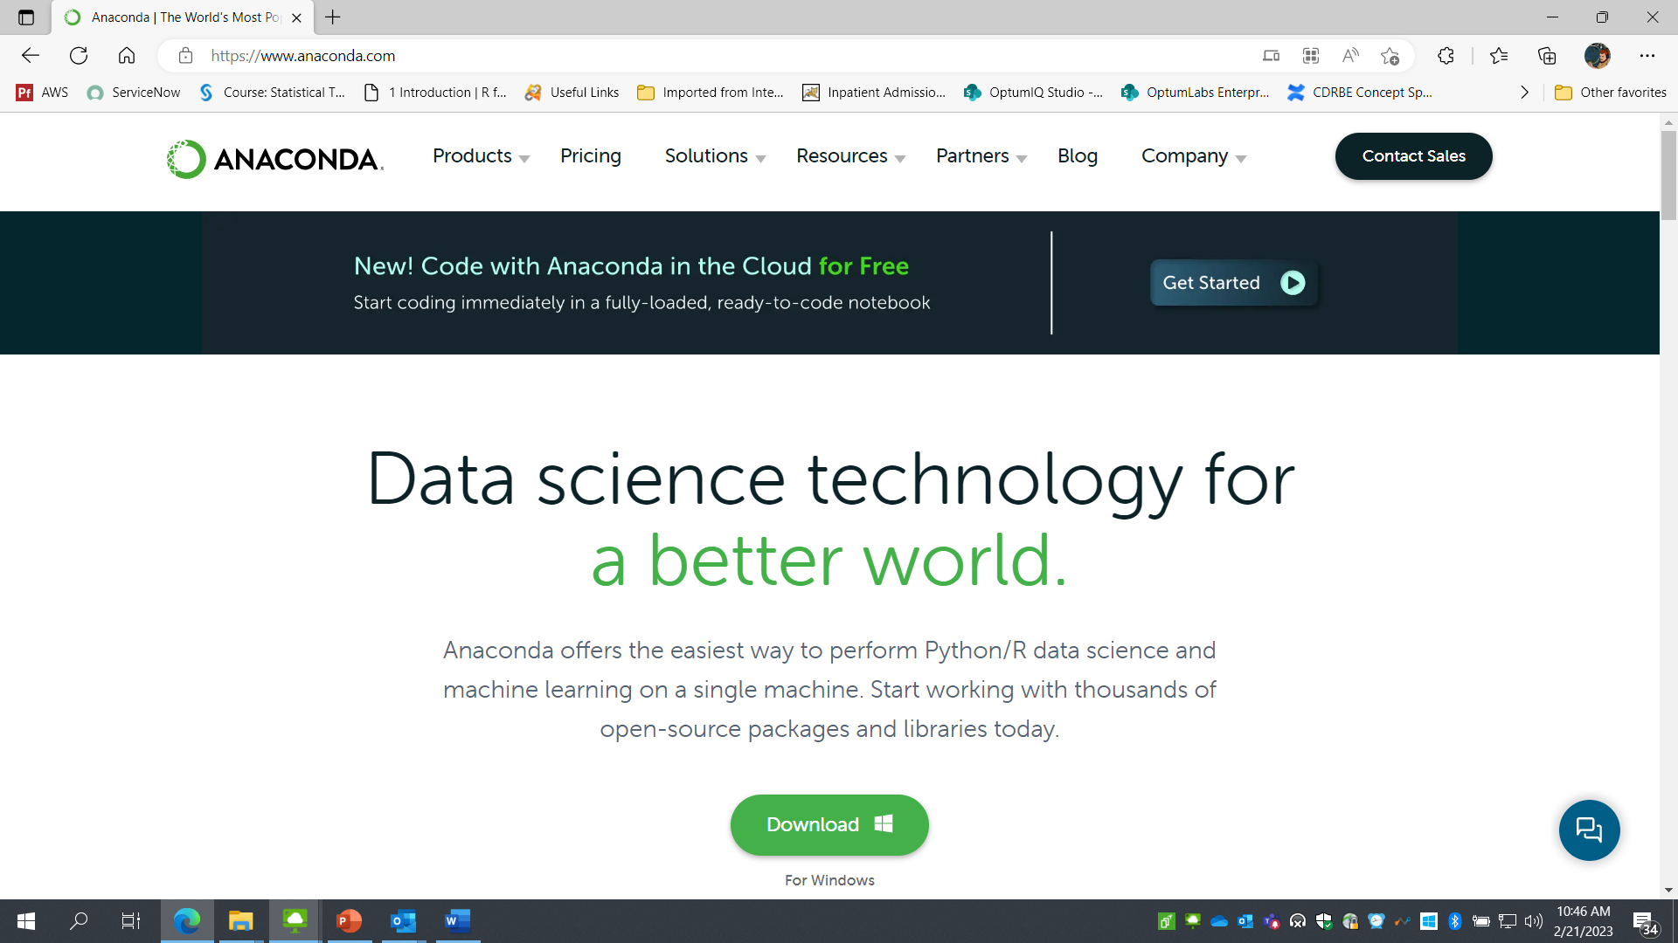
Getting Python with all the Bells and Whistles
Anaconda – Comes with a few hundred of the most popular packages available and all the fun extension, like Jupyter and Spyder

Slide 14
